Slide 1
Disasters in Dentistry
What to do when the unthinkable happens
January 21, 2024

Slide 2
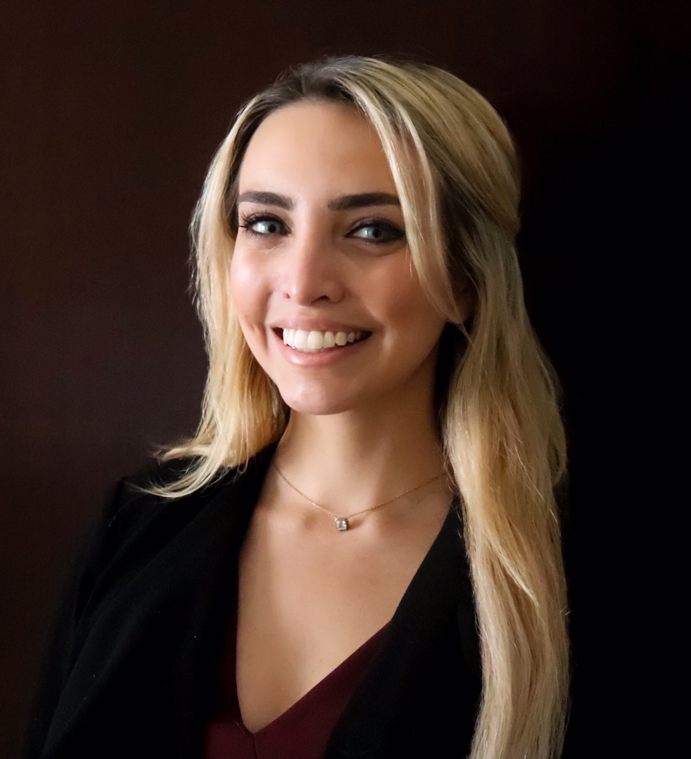
Speaker Bio
Jacqueline Clarke, J.D. Lead Senior Risk Consultant and Dental Claims Consultant, MedPro Group (Jacqueline.Clarke@medpro.com; 248-216-0644)
Jacqueline Clarke received her BA in Literature and Film from Kalamazoo College in 2010, and her Juris Doctorate from Michigan State University College of Law in 2013. She is admitted to practice law in both the Michigan and Illinois state courts, as well as the United States District Courts for the Eastern and Western Districts of Michigan.
Before joining MedPro Group, she worked as a litigation attorney at Smith, Haughey, Rice & Roegge in Ann Arbor, Michigan. There, she specialized in the defense of hospitals, healthcare facilities, physicians, nurses, and dentists in all stages of the licensing, claims, and litigation processes. She also provided risk management consultative services to a number of institutional clients, including the University of Michigan Health System, Spectrum Health, and Beaumont Health.
Jacqueline joined MedPro in 2018 and helped our dental division achieve a trial win rate of 95% and a closed without payment rate over 80%. Jacqueline’s responsibilities include developing and delivering risk management and patient safety services to MedPro-insured dentists, students, and national dental organizations. Jacqueline also serves in a business development role by providing educational seminars on risk reduction and proactive risk management to prospective clients, distribution partners and dental students.

Slide 3
Disclaimer
MedPro Group receives no commercial support from any ineligible company/
commercial interest.
It is the policy of MedPro Group to require that all parties in a position to influence the content of this activity disclose the existence of any relevant financial relationship with any ineligible company/commercial interest. When there are relevant financial relationships mitigation steps are taken. Additionally, the individual(s) will be listed by name, along with the name of the commercial interest with which the person has a relationship and the nature of the relationship.
Today’s faculty, CE planners, content developers, reviewers, editors, and Risk Solutions staff at MedPro Group, have reported that they have no relevant financial relationships with any commercial interests.
The information contained herein and presented by the speaker is based on sources believed to be accurate at the time they were referenced. The speaker has made a reasonable effort to ensure the accuracy of the information presented; however, no warranty or representation is made as to such accuracy. The speaker is not engaged in rendering legal or other professional services. The information contained herein does not constitute legal or medical advice and should not be construed as rules or establishing a standard of care. Because the facts applicable to your situation may vary, or the laws applicable in your jurisdiction may differ, if legal advice or other expert legal assistance is required, the services of an attorney or other competent legal professional should be sought.

Slide 4

The Industry Leader in Malpractice Insurance

Slide 5

MedPro Dental Highlights
Largest Dental Malpractice Insurer
#1 National Market Share
~48K Dentists and Specialists
Owned by Berkshire Hathaway
A++ Highest Financial Ratings in Industry
Protecting Dentists for over a Century
Leading Dental Claims Results
95% Trial Win Rate
82% Closed w/o Pay
Robust Policy
Pure Consent to Settle
Occurrence

Slide 6

Objectives
During today's program, we will discuss:
The current malpractice environment
Common categories of cases
"Disaster" claims in each category
Risk management considerations—preventing "disaster" claims
Informed Consent
Preoperative Errors
Intraoperative Errors
Postoperative Errors

Slide 7
Today's Malpractice Environment

Slide 8
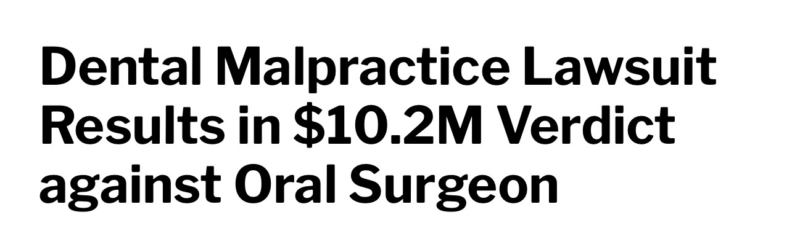
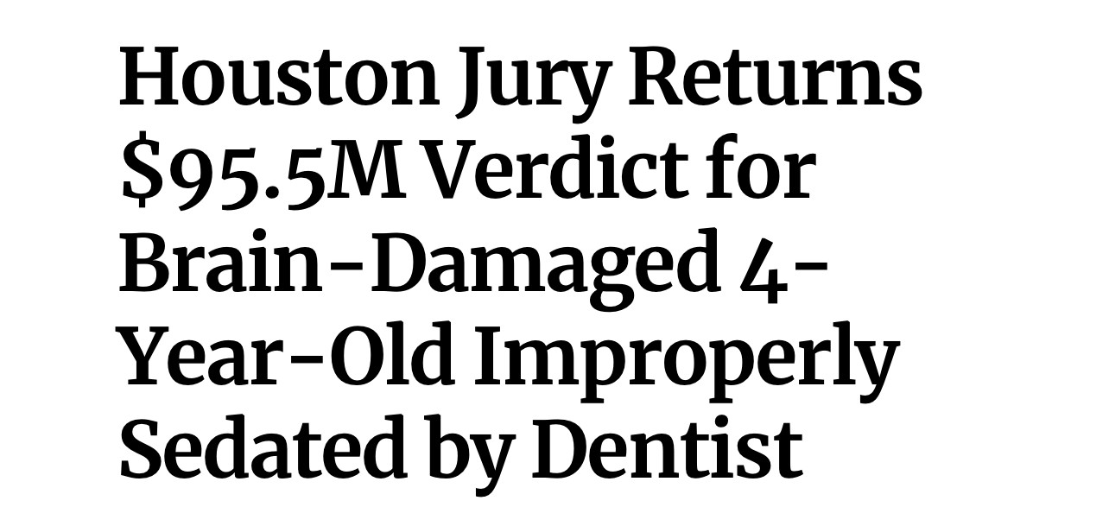
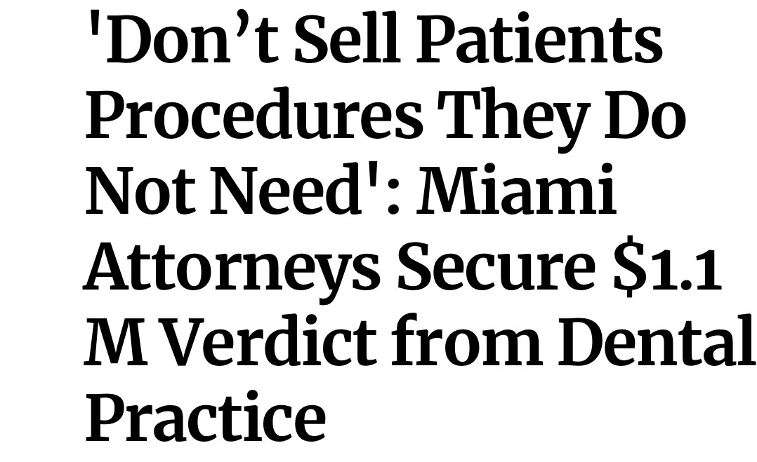
Today's Malpractice Environment
Dental claims frequency is rising after a decade of steady decrease.
Dental claims severity is also rising significantly:
  Average claim in mid-1990s = $19k.
  Average claim in mid-2000s = $39k.
  Average claim today = $90k.
Social inflation is contributing to the severity trend.
Plaintiff Attorneys are focusing on the service side of dentistry, to push the severity trend.
Notes:
The frequency and severity of claims is on the rise.
We'll discuss this more in our sections about documentation and patient communication but part of the way Plaintiff's Attorneys are making arguments to the jury and being awarded these massive damages is by focusing not only on the dental aspect of the malpractice claim, but also service side of dentistry.
Dentist didn't call the patient back when she had complaints
It looks like some records may have been altered
How do we know if the dentist is telling the truth if the visit wasn't thoroughly charted

Slide 9
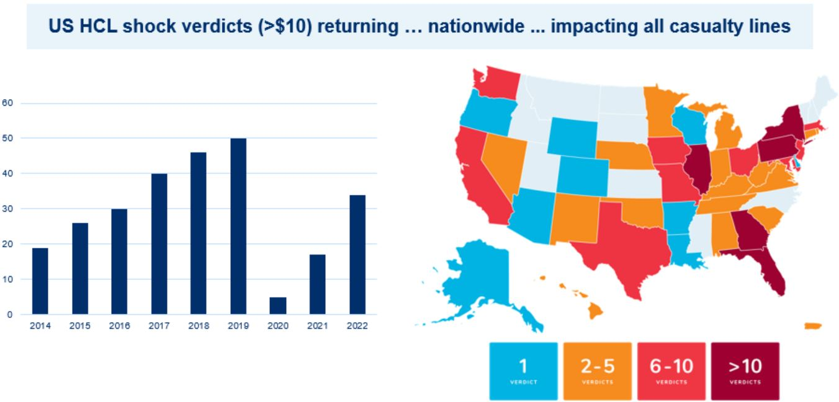
Increasing "Shock" Verdicts Nationwide
Notes:
Shock Verdicts are defined by verdicts over $10M. These verdicts are not just reserved for the dental specialty, but all other medical specialties.
You'll see that certain states are more volatile than others, and that is something that we are certainly mindful of in our Claims Department when we are assessing whether to take a case to trial .

Slide 10
Reasons for Today's Malpractice Environment
Practicing Beyond Abilities
Patient / Juror Expectations
Societal View of the Legal + Medical Systems
Societal View of a Dollar's Worth
Consumer Culture—patient as a buyer of a service
Work/Debt Conundrum
Red Flag Patient Groups

Slide 11
Key Definitions

Slide 12
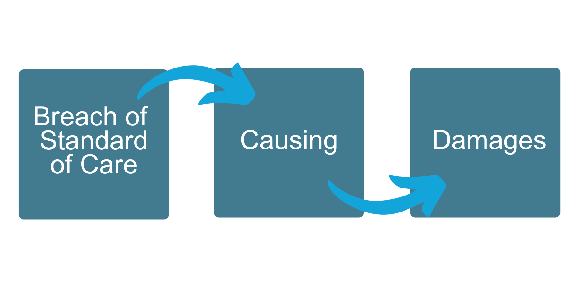
Professional Malpractice—Definition
When a medical professional provides care that diverges from what is accepted as the standard of care as recognized by the medical community, which directly causes damages.
Notes:
[Read slide]
There are 3 main elements to a malpractice claim: (1) liability, or a breach of the standard of care, (2) causation, and (3) damages.

Slide 13
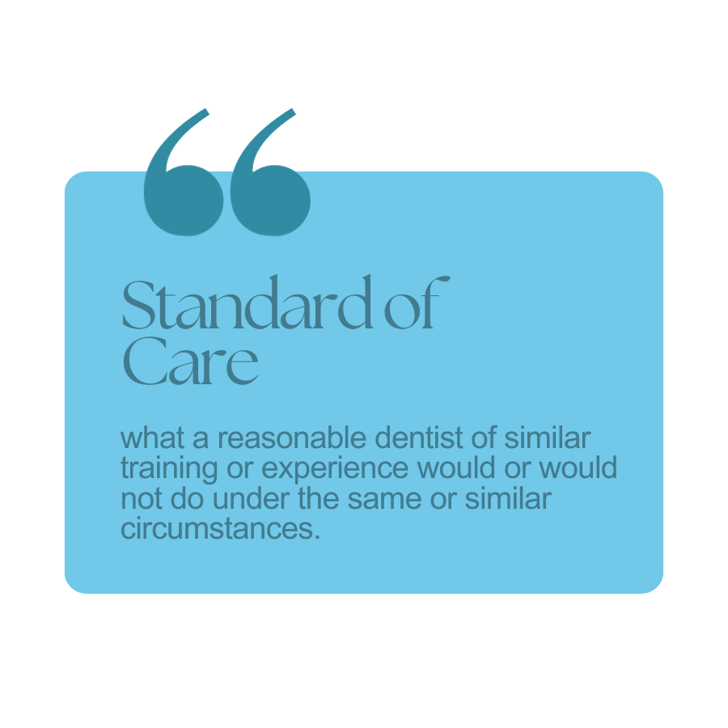
Who or What Determines the Standard of Care?
Notes:
The big thing that we are all focused on in defending in malpractice cases is did our insured comply with the standard of care.
The standard of care is defined as what a reasonable dentist of similar training or experience would or would not do under the same or similar circumstances.
How is that proven?

Slide 14
Informed Consent
[or lack thereof]

Slide 15
Informed Consent Errors
Occurs due to:
Poor Communication
Clerical Error
Patient Selection
Examples:
    Failure to disclose particular risks of the procedure;
    Failure to tailor consent to the individual patient;
    Failure to advise patient of alternatives to treatment (e.g. RCT vs Extraction);
    Clerical error—getting consent for the wrong patient or procedure

Slide 16

Minimum Disclosures + The Informed Consent Discussion
  The patient's current condition?
  The proposed intervention / treatment options? (both in medical and layman’s terms)
  Explanation of the purpose of the procedure
  Important risks & benefits (those the patient may consider important & those that may affect the patient’s decision to accept/reject the recommendation)
  Risks if the treatment not undertaken
  Alternatives to the proposed procedure/treatment, including no action
  Expected outcomes
  The patient’s questions and understanding of the proposed plan
Failure to cover any of these disclosures, or failure of the patient to understand any of these disclosures, may set the stage for a subsequent malpractice action.
This duty is non-delegable.

Slide 17
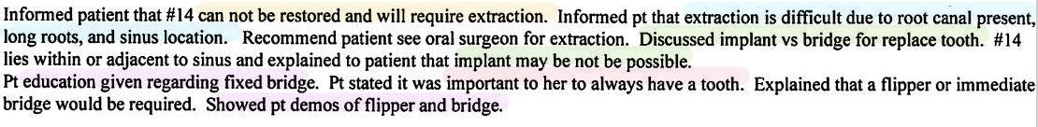
Informed Consent & Documentation—A Good Example
Condition & Suggested Treatment
Risks of Suggested Treatment
Patient Education
Options in Compromise
Patient Desires

Slide 18

Customized Consent
Patients cannot make an informed decision about their own risks or benefits with any given therapy based solely on population-wide data. They need estimates based on their own unique characteristics.
Miller, R. (2011, November 15). Customized informed consent improves communication. Medscape. Retrieved from www.medscape.com/viewarticle/753598

Slide 19
Case Study #1: Informed Consent
Patient
Summary
Outcome
30-year-old male professional trumpet player had an asymptomatic deep vertical FBI #32 and a perio defect distal to #31.
A PA showed the M root within 2-3mm of the IAC.
The practitioner's assistant discussed the risks, benefits, and alternatives, and also advised the patient of the risk of paresthesia.
The patient was provided with a consent form. He signed the form, although he admitted he did not read it.
The surgery was uneventful. #32 was sectioned, and the roots were removed.
After 1 week, the patient was found to be numb over the V3 distribution. He was "slightly less numb" at the 1 month visit. He was referred to an OMFS after 6 months.
The Problem: Because the patient was numb, he could not embouchure to play the trump, and could not return to his career.
Issues?

Slide 20
Case Study #1: Informed Consent
Other Tx Options
#32 was asymptomatic when the patient presented – did the tooth need to be extracted?
A coronectomy could have been performed.
Extent of Discussion
The informed consent discussion was done by the dentist's assistant (non-delegable).
The patient's profession as a trumpet player was not taken into consideration – there was no specific discussion with him about how an injury could impact his career (no embouchure warning).
The patient's claim that he did not read the informed consent document?

Slide 21
Informed Consent Risk Tips
Adequate and effective informed consent is a process, not merely a form.
Proper implementation of the informed consent process helps engage patients in their care and should be viewed as a tool that supports shared decision-making.
The "teach-back" method can help gauge patient comprehension of information received during the informed consent process.

Slide 22
Preoperative Treatment Error
Surgical Errors

Slide 23
Preoperative: Surgical / Treatment Errors
Occurs due to:
Poor pre-procedure planning;
Practicing beyond one's ability;
Poor communication;
Clerical errors in communication
Examples:
    Extraction of the wrong tooth;
    Perforation of a root during a root canal;
    Wrong-sided surgery;
    Inadvertent placement of implant in IAN canal space; and
    Severing or otherwise injuring a nerve (IAN, LN) during third molar
    extraction

Slide 24
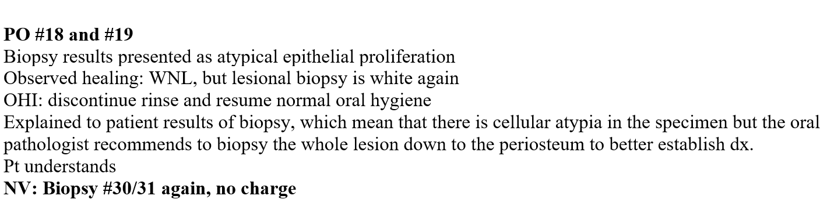
Case Study #2: Preoperative Treatment Errors: Surgical Pre-Op
Case st dicates
Patient
Summary
70 YOF former attorney, C, presented to her general dentist for a cleaning. Her general dentist noted an area of abnormality along the buccal gingival margin of #18 and #19 on the left side of C's mouth. He referred her to a periodontist.
Periodontist biopsied the area, and sent the biopsy to pathologist.
Pathologist returned a temporary dx of "atypical epithelial proliferation" but advised he needed a larger tissue sample. He sent a note to the periodontist.
The Perio re-examined C and took another biopsy.
His chart note read:

Slide 25
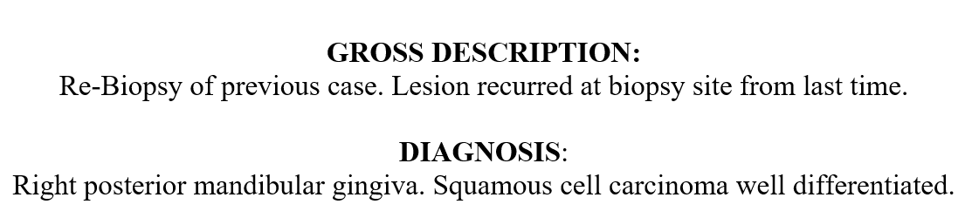
Case Study #2: Preoperative Treatment Errors: Surgical Pre-Op
Case st dicati3s
Summary
The Perio's requisition form to the pathologist reads:
The Perio wrote a referral to an OMS stating “an area of concern around #30 and #31”.
The OMFS examined the patient, and noted an abnormality on the left side of the patient’s mouth.
The OMFS scheduled the patient in hospital for a “limited marginal mandibulectomy including a modified radical neck dissection”.

Slide 26
Case Study #2: Preoperative Treatment Errors: Surgical Pre-Op
Case st dicati3s
Summary
On day of surgery, C was examined by the anesthesia team. They began examining the R side of her face. C explained they had the wrong side and surgery was to be performed on her L side.
The Anesthesiologist noted the chart as to his conversation with the patient.
The OMS did not speak with the patient beforehand.
Intraoperatively, he prepared the right side of the patient’s mouth. The OR team stopped the OMSS, and stated per the patient and the Anesthesiologist, this was the wrong side.
The OMS reviewed: (1) the referral from the Perio, (2) the second pathology report.

Slide 27
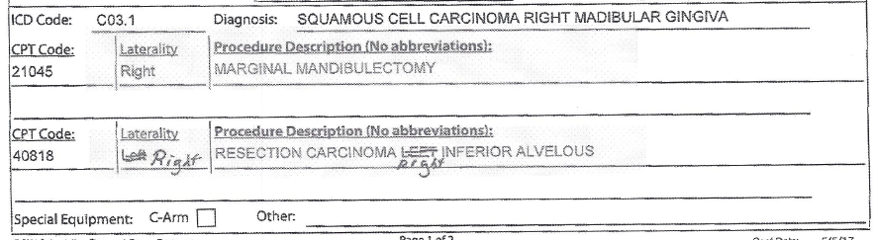
Case Study #2: Preoperative Treatment Errors: Surgical Pre-Op
Case st dicati3s
He then does this:

Slide 28

Case Study #2: Preoperative Treatment Errors: Surgical Pre-Op
No documented instances by insured or his staff to follow-up with the patient when he missed his subsequent appointments.
Documentation Error
Poor Team Communication
Pre-Op System Failure
Clear
Multiple studies show the quality of team communication directly impacts the clinical outcomes of patients
Make it easier for staff to speak up – implement a critical language policy

Slide 29
Case Study #2: Preoperative Treatment Errors: Surgical Pre-Op
Poor Team Communication
Pre-Op System Failure
No pre-op site verification by OMS
Time-Out Protocol
When in doubt . . . stand still
Good Team Communication directly impacts the clinical outcomes of patients.
Make it easier for staff to speak up – implement a critical language policy
Notes:
Large study of hospital ICUs rated the quality of teamwork and team communication across organizations
In those ICUs where the quality of communication was ranked in the top 20%...
Discharge return rates were 5%, vs 16% for the other organizations
From a critical mortality rate standpoint, patient's chance of survival doubled

Slide 30
In Summary
The performance of dental procedures on the wrong teeth most commonly occurs due to miscommunication, clerical errors, and dentist oversight.
In many cases, dentists fail to recognize they have rendered treatment on the incorrect tooth, which can further anger patients, and increase litigiousness.
Preventative measures, including pre-procedure time-outs can reduce the potential for performing work on the wrong tooth.
Independent evaluation of symptoms and patient complaints as well as informed consent confirmation from the patient can serve as a defense in a wrong-tooth case.

Slide 31
Intraoperative Errors
Anesthesia

Slide 32
Intraoperative Errors
Occurs due to:
Poor patient selection
Poor management of the patient intraoperatively
Communication Errors
Examples:
    Failure to properly does anesthetics;
    Failure to monitor during anesthesia;
    Failure to recognize signs + symptoms of distress;
    Failure to timely intervene; and
    Failure to timely complete an anesthesia record

Slide 33
Case Study #3: Intraoperative Treatment Errors: Anesthesia
Patient
Summary
Intraop
Course
18 year-old patient, J, with history of nonverbal cerebral palsy and seizure disorder brought to insured, K, for dental treatment under anesthesia.
J underwent treatment with Dr. K and a team of two residents at a local hospital.
J received an IM injection of Ketamine 200 mg. He was then nasally intubated with a size 5.5 tube in his R nostril; the tube was uncuffed.
The patient was administered the following:
Ketamine 200 mg, Midazolam 5 mg; propofol 3000 mg on infusion pump; dexamedomidine 8 mcg, remifentanil 280 mcg
The team then performed 18 composites and 2 extractions.
During procedure, J's pulse ox, BP, heart rates, and end tidal Co2 were monitored constantly.
Hours into the procedure, Resident A noted there appeared to be a desaturation.
Dr. K was not in the room, and Resident A went to get him.
Dr. K scoped the patient, and saw nasal tube was slightly out of trachea. He re-inserted it promptly without issue.

Slide 34
Case Study #3: Intraoperative Treatment Errors: Anesthesia
Records
End of Tx
PACU
The anesthesia record was not charted contemporaneously with treatment.
Dr. K's reintubation attempt, including how long it took, was not charted.
The EKG machine was turned off at 5:05 pm.
The Residents allowed J's father to come into the surgical suite and cut J's hair and nails.
Anesthesia was then discontinued at 5:50 pm. Upon extubating the patient, Resident A noted there appeared to be blood in the ET.
J was monitored in the PACU for 70 minutes. Dr. K gave J's dad post-op instructions. He did not tell J's father re: the desaturation episode that happened intraoperatively.
J's father took J home.
The next day, Dr. K received a call from J's dad indicating J had desaturated at home, and had died.
Issues?

Slide 35
Case Study #3: Intraoperative Treatment Errors: Anesthesia
ET Tube Not Cuffed
Uncuffed tubes prone to migration especially in long procedures.
Tip: Deflate balloon cuff to prevent necrosis
Anesthesia Record-Keeping
Need to have all vitals charted;
If there is a change in BP, O2 sats, RR, or HR, records need to indicate:
  Intervention type
  How long it took to take intervention
  Result of intervention attempts
Clinical Notes & Electronic Tracings must match
"Blood in ET Tube" . . . Need f/u
Changes to Anesthesia Chart
Document when changes made and why

Slide 36
Case Study #3: Intraoperative Treatment Errors: Anesthesia
Preop Clearance
Consider "red flag" patients, or patients with comorbidities.
Does PCP know exactly the procedure the patient will undergo.
No Notation re: Catheter
Need to know fluid input/output especially during long procedures
No indicia whether temperature being taken—important when coupled with no fluid data.
J's father was not told about the desaturation episode, and s/s of future episodes to watch for at home.

Slide 37
Post-Treatment Errors
Failure to Follow-Up

Slide 38
Postoperative Errors: Failure to Follow-Up
Occurs due to:
Poor patient communication
Poor management + office follow-up systems
Clerical error
Examples:
    Failure to detect + diagnose oral cancer;
    Failure to detect + diagnose nerve injury;
    Failure to timely diagnose a mandibular fracture;
    Failure to recognize signs + symptoms of an infection and refer patient for antibiotics or refer patient on for future treatment; and
    Failure to f/u on ordered labs + imaging.

Slide 39
Case Study #4: Postoperative Errors: Failure to Follow-Up
Patient
Summary
52 YOF M presented to Dr. A with diffuse pain around #31.
Dr. A examined M and performed a full clinical evaluation. Symptoms were localized and severe to #31.
Dr. A recommended a RCT, and M agreed. During the RCT, Dr. A found vital tissue within the tooth, and did not prescribe abx.
Dr. A discharged M, and made a follow-up appointment for 1 week later.
2 days later, M called Dr. A's office in extreme pain. The call went unanswered.
A day later, M called again + spoke with Dr. A's assistant, T, and told her Tooth #29 was also in pain, and he was having jaw swelling.
T said she would speak with Dr. A and call M back.
Dr. A advised he thought #31 was having a "flare-up" and called in a prescription for Pen VK (for possible infection) and Medrol (for inflammation). T called M back and relayed in information.
M asked T if Dr. A was available to speak, and T advised "not today."
A day later, T presented to the ER with extreme pain. He was diagnosed with a necrotizing fasciitis that required multiple surgical debridement, and an extensive hospitalization.
Outcome

Slide 40
Case Study #4: Postoperative Errors: Failure to Follow-Up
Pre-Op Abx Prescription
Patient's call to the office:
A cc: swelling, but he was (a) never told to come in; (b) not asked about extent of swelling or location.
A should have been told to come in when he cc: swelling.
Dr. M never called A back to check in.
Should never have given Medrol as it is a corticosteroid + will reduce ability to fight infection.
Judgment call
Modern trend is to steer clear of prescribing abx when not warranted.
Although follow-up is imperative, setting the foundation through good patient communication can keep most of these cases from evolving in the first place

Slide 41
Case Study #5: Postoperative Errors: Failure to Follow-Up
Patient
Summary
40 YOM, S, presented to Dr. M for a prophy visit. Dr. M noted a lesion on the inside of the S's right cheek, and asked if he had been chewing on it. S denied this.
Dr. M advised the S he wanted to see him back in 1 month for a recall appointment. S did not return for 3 months. Dr. M observed there was still a slight abnormality on the inside of the cheek. Advised S to return in 1 month. Dr. M intended to biopsy the area if the S returned with an abnormality.
S did not return for 1 year and 7 months.
When S did return, he complained of pain in his jaw and in his gums. Dr. M observed a more prominent lesion on the inside of the S's cheek, and took a biopsy.
S was diagnosed with squamous cell carcinoma of the jaw, requiring a hemimandibulectomy, bone grafting from his leg, chemotherapy, and radiation. S has had two subsequent reoccurrences of his cancer.
Outcome
Issues

Slide 42
Case Study #5: Postoperative Errors: Failure to Follow-Up
Follow-Up Undocumented
No documented instances by insured or his staff to follow-up with the patient when he missed his subsequent appointments.
Follow-Up Needed
Yes, the patient delayed in following up with insured because of travel.
But given the abnormality observed, it was incumbent to the insured to:
Explain why the patient needed to follow-up, and
Call the patient when he did not return and advise him to follow-up.
Had the patient followed-up as necessary, it is likely the lesion could have been resected using less invasive means

Slide 43
What is different about Post-Op Systems Failure Cases:
More About:
Less About:
Communication between patient/family and dentist/staff
Communication among providers
Failure/delay in obtaining consult/referral
Lack of/failure in patient follow-up system
Expert testimony at trial is less important
Patient assessment issues
Clinical interpretation of dx studies
Clinical failures

Slide 44
Follow-Up System Failures: Risk Considerations
No news is NO NEWS.
Utilize your patient as your last line of defense
Staff engagement and responsibility is imerpative
Try to stay away from: “If you haven’t heard from us by…”
Practice needs to take responsibility and set communication + appointment follow-up's.
But all "negatives" must be brought to dentist's attention; no medical/dental advice from staff to patient … EVER!

Slide 45
Your Malpractice Carrier
How it can (should) help

Slide 46
How Your Malpractice Carrier Should Help
Team Approach
The Insured, Claims Consultant, Risk Consultant, and Defense Attorney should all work collaboratively.
Frequent communication with insureds about what is in their best interests
Pure Consent Clause available in policies for settlement.
Communication
Opportunity for additional training, CE's, and individual Q&A sessions with member of our Risk Team.
Strong risk-benefit analysis to make informed decisions regarding settlement versus trial
Paying the reasonable value of the case; not overpaying just to dispose of the case
Risk
Claims

Slide 47
Malpractice Insurance: What Should I Look For?
Strength
Financial Health + Ratings
Know what you are purchasing—
- Claims Made vs. Occurrence
- Consent to Settle
Coverage
On-Site teams with depth + experience
Ability to discuss w/ experts in real-time + developing situations
Expertise in nationwide defense counsel
Avoid sacrificing quality for cost
Risk &
Claims
Price

Slide 48

@MedProDental
dental@medpro.com | 800.4MEDPRO | medpro.com/dentists
Jacqueline Clarke, Esq. 248-216-0644 Jacqueline.Clarke@medpro.com

